Slide 1
Behaviorism:
A framework for dynamic
data visualization
Angus Forbes, Tobias Höllerer, George Legrady
Media Arts & Technology
Experimental Visualization Lab
Imaging, Interaction, Innovative Interfaces Lab
University of California at Santa Barbara

Slide 2
Behaviorism
is a programming framework
for creating information visualization projects,
especially ones
that use dynamic data.

Slide 3
Overview/Background
Design decisions
Architecture
Conclusion/Future

Slide 4
The Behaviorism framework
simplifies the creation of visualization projects
by providing tools
to collect, manage, and render data,
without sacrificing
robustness or flexibility.

Slide 5
Behaviorism makes it easy to create
interactive graphics and animations
using
a hardware-accelerated OpenGL renderer,
a flexible scene graph,
and
a set of customizable graphics and media objects.

Slide 6
Behaviorism handles streams
of complex, heterogeneous data.
Data is stored in a graph structure
which can be connected with semantic links
and updated dynamically.
Extensible tools are provided which can be used
to collect, parse, integrate data,
and also to analyze data.

Slide 7
Why another framework?
To fill the niche between media arts frameworks
and info visualization frameworks
by providing tools for both
modeling / managing data and rendering
Easy to turn prototypes into robust systems

Slide 8
A unified set of Behavior objects are used to model various aspects of the visualization project.
Behavior objects are extensible, concurrent controllers
which handle the logic and timing of
data collection and data integration processes,
graphical layout and animation of data,
and
the effects of user interaction.

Slide 9
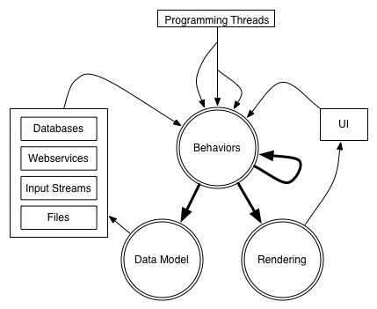

Slide 10
Overview/Background
Design decisions
Architecture
Conclusion/Future

Slide 11
Cell Tango - George Legrady and Angus Forbes
w/Christopher Jette
Projected multimedia installation
of user-submitted cellphone photography
and tagged photos from Flickr.com.
Currently installed in Poznan, Poland as part of a media biennale.

Slide 12
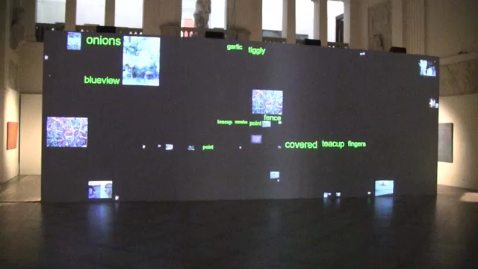

Slide 13
Behaviorism
supports incoming data from various external data streams
supports robust multimedia installations
animation is easy to program and synchronize

Slide 14
Tag River - Basak Alper and Angus Forbes
An interactive information visualization project
utilizing data from Last.fm
showing listening trends over time.
Hybrid of theme river / tag clouds.
Two modes: interactive and ambient

Slide 15
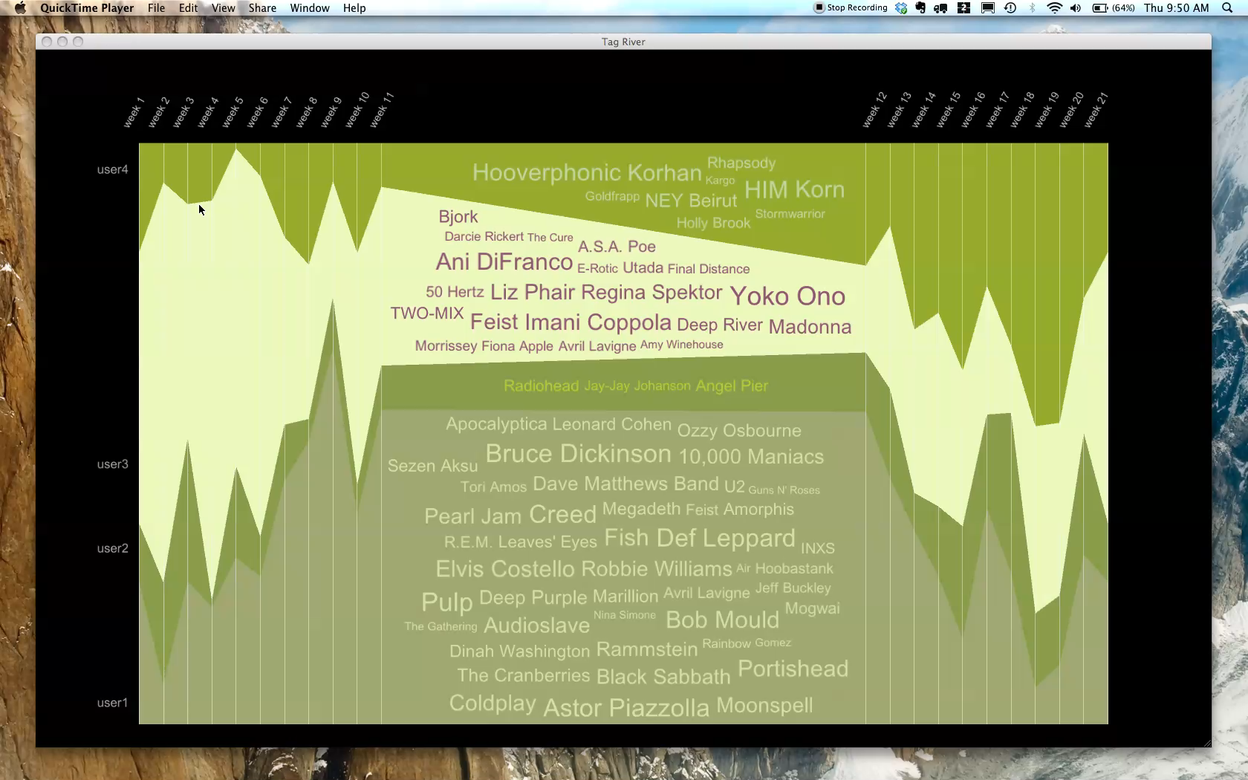

Slide 16
Behaviorism
supports desktop information visualization projects
can manage both user interaction threads and programmatically defined animation threads
easy to create visual metaphors

Slide 17
Overview/Background
Design decisions
Architecture
Conclusion/Future

Slide 18
Architecture of framework is segmented
into 3 main areas:
Rendering (Geoms) - Scene Graph
Data Operations (Nodes) - Data Graph
Scheduling and Control (Behaviors) - Timing Graph

Slide 19
The rendering of geometry is split into two sections:
1. The scene graph is traversed, the modelview of each Geom is calculated, and then the Geom is placed within a particular RenderLayer.
2. Each RenderLayer is sorted and traversed, lighting, material, blending, and other state is set, shaders are bounds, and then each Geom is rendered using OpenGL commands.

Slide 20
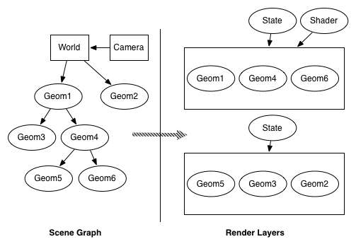

Slide 21
Data Graph
All data used in the visualization project has an internal representation or proxy on the Data Graph.
The Data Graph is heterogeneous, semantic,
traversable, filterable, analyzable, and dynamic.

Slide 22
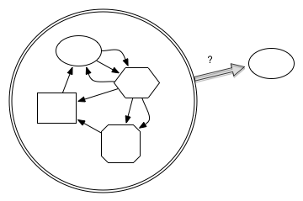
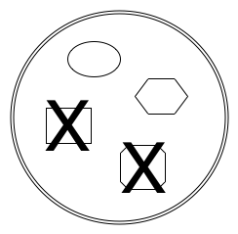
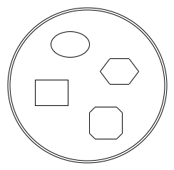
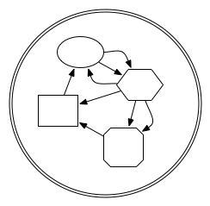
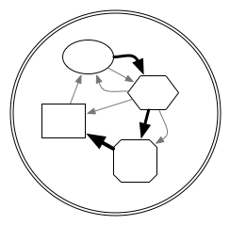
heterogeneous
semantic
analyze
filter
traverse

Slide 23
The data graph is conceived of as a dynamic entity,
which can constantly change
due to incoming streams of data,
programmatic additions and deletions,
or in response to user-interaction.

Slide 24
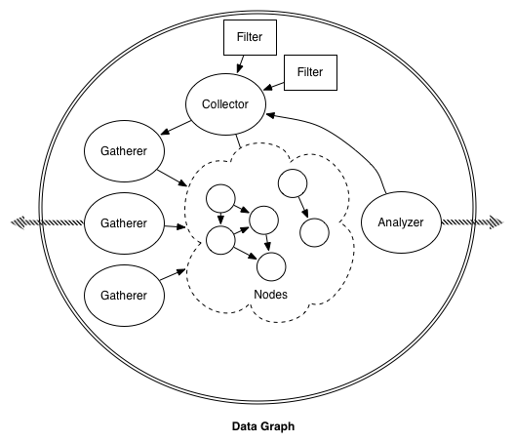

Slide 25
Data Flow - George Legrady and Angus Forbes
A 3-panel data visualization installation
displaying a series
of real-time statistics for a corporate website.
The streaming data consisted of information about user's searches.
The GeoMap visualization shows the most frequent search locations over the course of the last hour, sped up over 5 minutes.

Slide 26
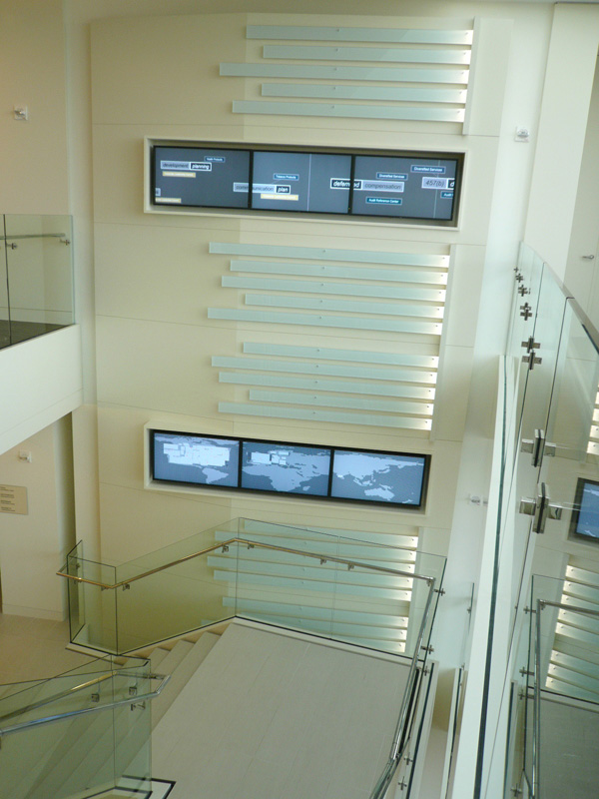
Data Flow - George Legrady and Angus Forbes
A 3-panel data visualization installation
displaying a series of real-time statistics for a corporate website.

Slide 27
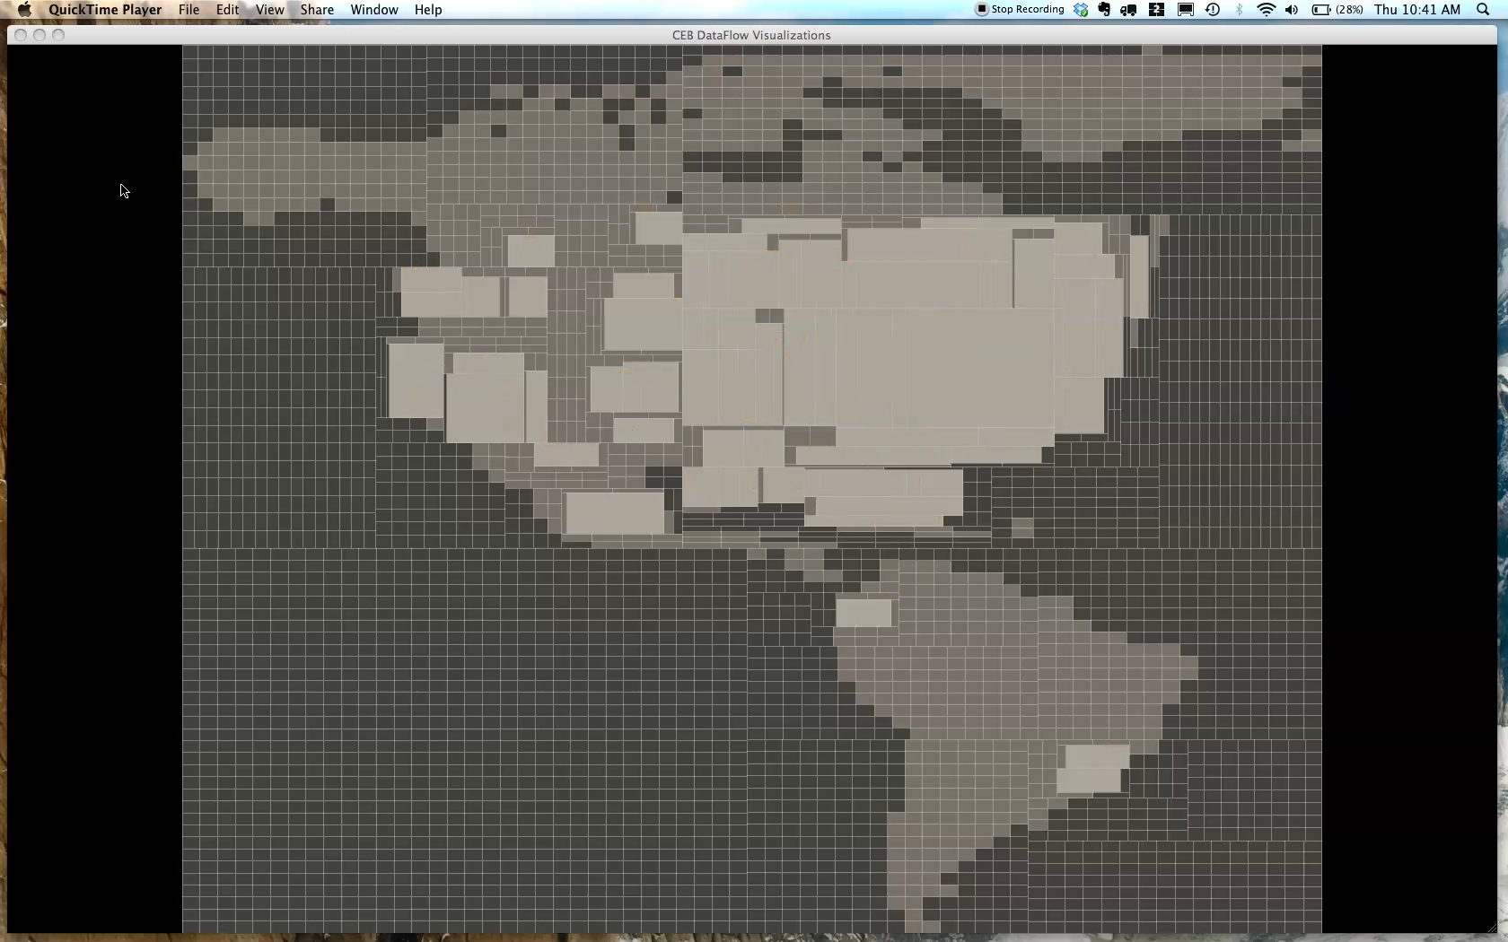

Slide 28
Behaviorism
makes it easy to gather, parse, filter, and analyze data.
This project handled up to 100,000+ events per hour at peak times of the day.
No longer active, but ran for one year at a corporate headquarters in DC.

Slide 29
Timing Graph (Scheduler)
The Timing Graph contains Behavior objects which control the flow of the visualization system:
scheduling the gathering and analysis of data,
creating and deleting the creation of Geoms,
controlling animation, attribute updates, and state changes,
responding to user-interaction
and updating other Behaviors

Slide 30
Each Behavior is responsible for executing some logic which effects one or more items on the Scene Graph, the Data Graph, or the Timing Graph itself.
Behaviors provide a uniform interface for safe updates to the underlying concurrent data structures.

Slide 31
Behaviors are:
stackable - a single behavior can be applied to multiple elements;
chainable - multiple behaviors can be chained together to create more complex behavior;
flexible - behaviors can be extended to provide custom functionality;
mutable - the effect the behavior has on another object can change either dynamically (via another behavior) or programmatically;
relative - a behavior does not interfere with other behaviors concurrently updating the same element.

Slide 32
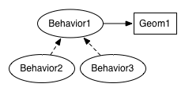
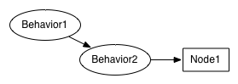
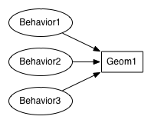
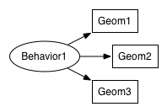
Stackable
Relative
Chainable
Mutable

Slide 33
Coil Maps - Angus Forbes
An interactive data visualization project
that lets users browse archival photography
which is stored in an animated grid of cells.

Slide 34
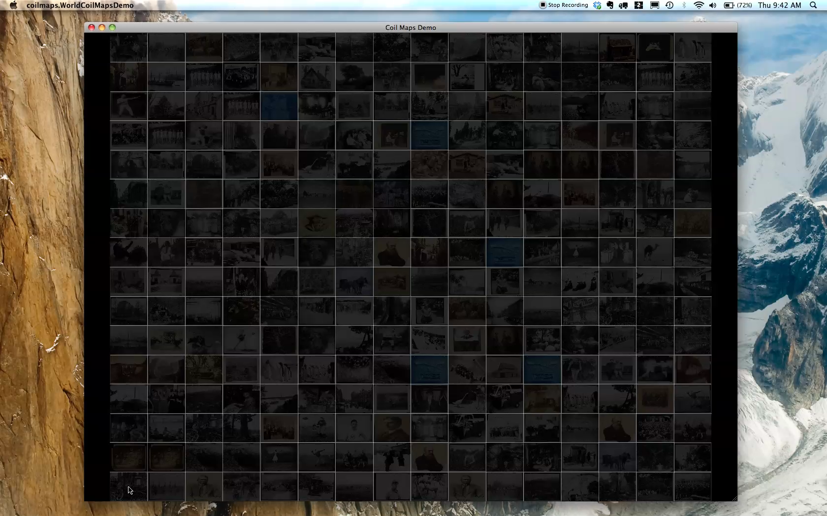

Slide 35
Take away = lots of behaviors running simultaneously...
all correctly handled by the timing graph when the scene graph is updated

Slide 36
They are split into 2 families:
Discrete and Continuous
XXXX

Slide 37
Discrete Behaviors run once at a specified time, or repeatedly at set intervals.
They control such things as:
triggering a data gathering event;
how often a data analysis should be performed;
changing the state of Geom objects;
adding or deleting elements from the system.
After they are executed, they can reschedule themselves.

Slide 38
Continuous Behaviors run continuously between a specified start and end time.
They control such things as:
changing the location or attributes of a Geom;
changing the values of a data Node;
changing the speed of an animation;
altering the effect of another Behavior.

Slide 39
Each continuous Behavior updates itself at the same speed as the screen refresh rate (60fps).
An easing function can be attached to the Behavior to change the way an attribute is interpolated (linear interpolation is the default).

Slide 41
Conlusion....

Slide 42
Some future directions are... to use this frameowrk on more projects...
Thinking integrating the data model and behaviors into Processing...
I've been working with a language called Scala... reduces code and help think about ...
have given this framework for other people and am conducting long term media arts usage studies...

Slide 43
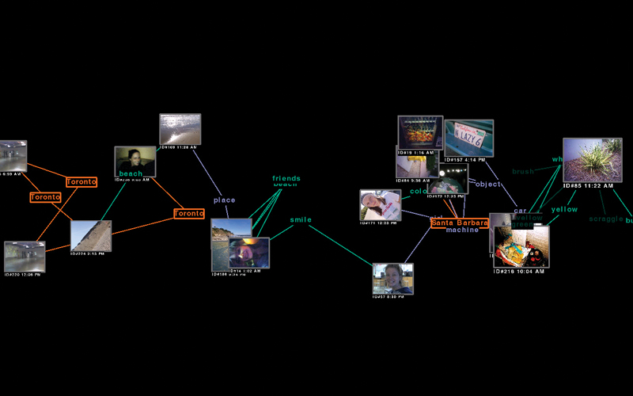
Visual...
link to code repo

Slide 44
Geom g = new GeomRect(new Point3f(), 1f, 1f);
BehaviorTranslate bt = new BehaviorTranslate(
new ContinuousBehaviorBuilder(Utils.now(), 5000L)
.isReversing(true)
.repeats(3)
.easing(new EasingPolynomial(OUT, 5);
.ranges(+3f,0f,0f);
Scheduler.getInstance().attachGeom(bt, g);

Slide 45
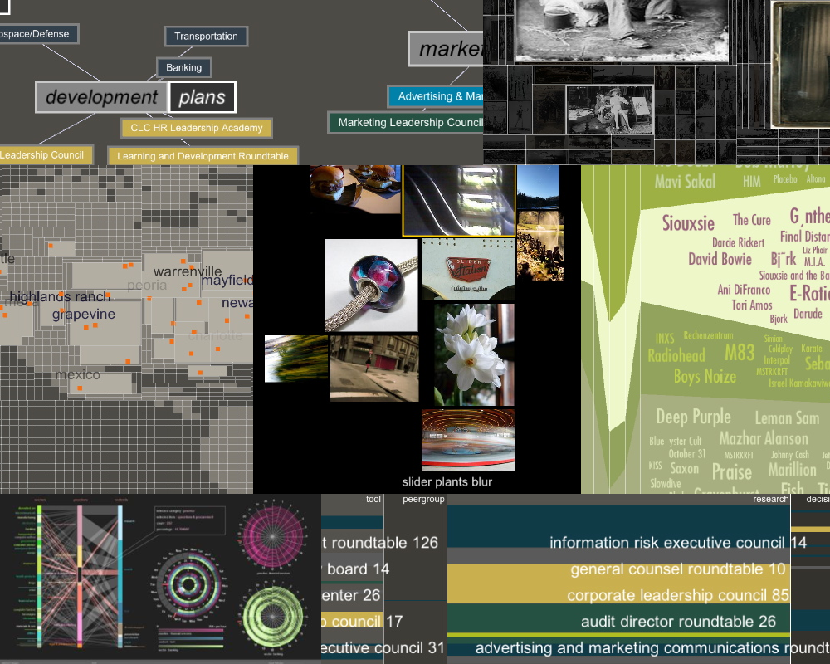
Thanks!
Question, etc? email angus.forbes@mat.ucsb.edu
source code available at http://github.com/angusforbes/behaviorism
(new version will be pushed to public repo soon!)

Slide 46
/*** Attaching a animation Behavior to a Geom ***/
//create a new Geom
Geom g = new GeomRect(new Point3f(), 1f, 1f);
//create a translation animation Behavior
Behavior bt = BehaviorTranslate.translate(
Utils.nowPlusMillis(10000L), 5000L, new Point3f(3f, 0f, 0f));
//attach the Behavior to the Geom
Scheduler.getInstance().attachGeom(bt, g);
//attach the Geom to the SceneGraph
addGeom(g);

Slide 47
/*** Behavior updating another Behavior ***/
long baseTime = Utils.nowPlusMillis(10000L);
//create a new Geom
Geom g = new GeomRect(new Point3f(), 1f, 1f);
//create a translation animation Behavior
Behavior bt = BehaviorTranslate.translate(
baseTime, 5000L, new Point3f(3f, 0f, 0f));
//attach the Behavior to the Geom
Scheduler.getInstance().attachGeom(bt, g);
//create a Behavior that speeds up the animation Behavior
Behvaior bs = new BehaviorSpeed(Utils.nanoPlusMillis(2500L), 2f);
//attach the Geom to the SceneGraph
addGeom(g);

Slide 48
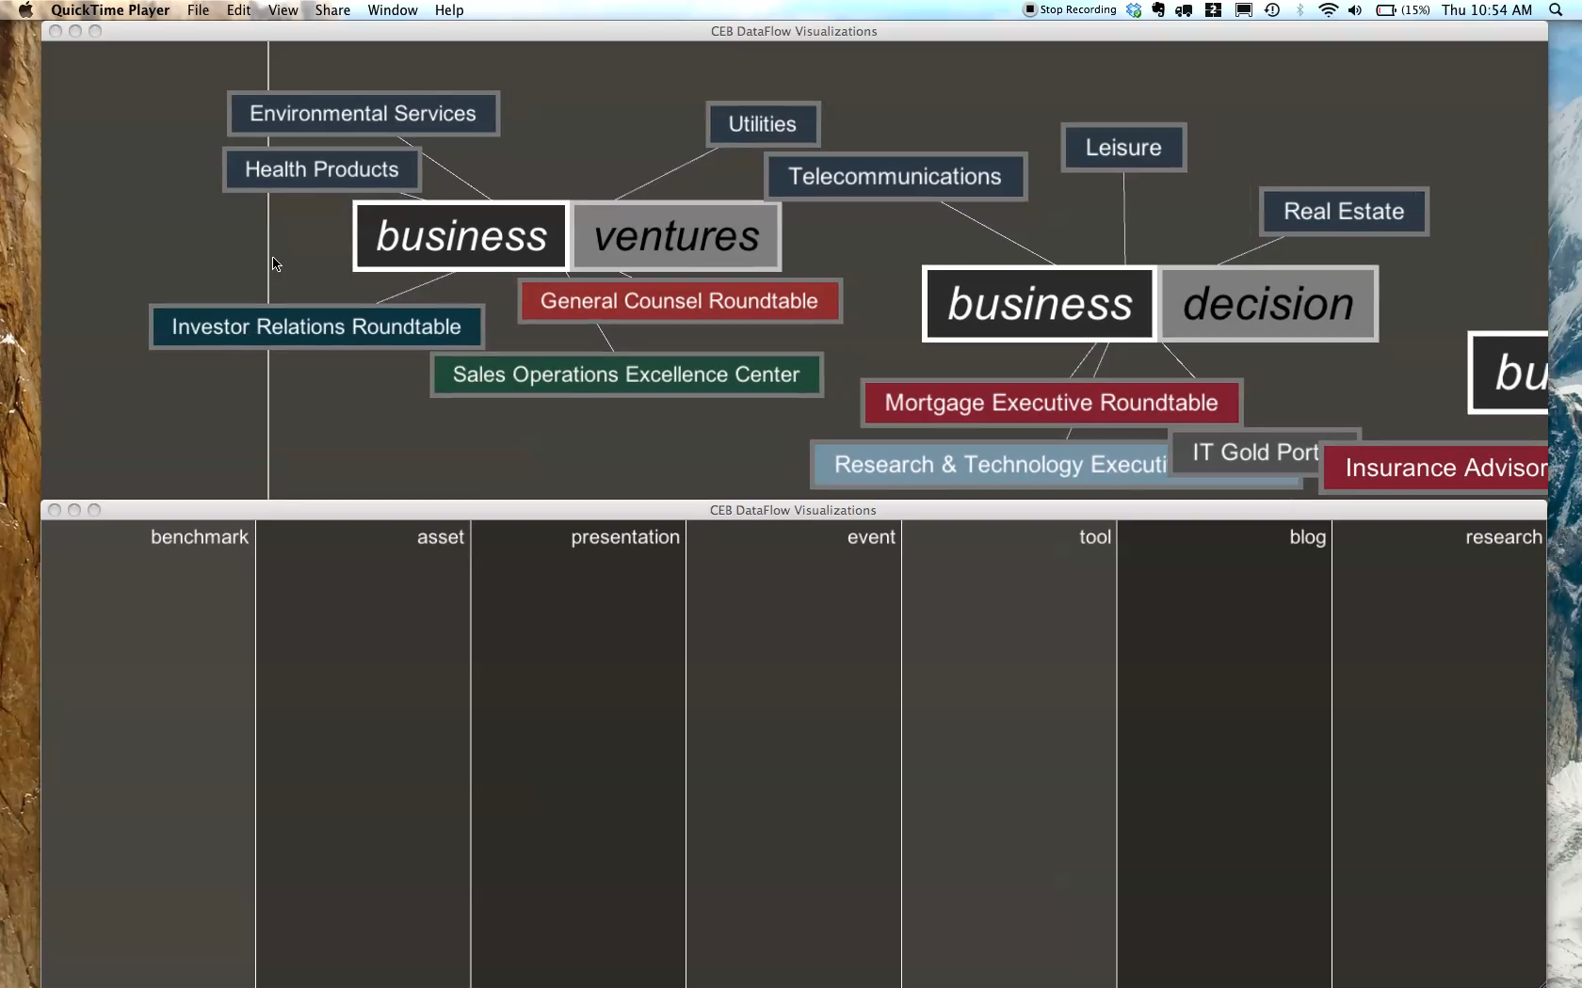

Slide 49
time behaviors are made simple...
easy to synchronize,
can be spawned safely from multiple threads
show code snippet..
maybe simple demo of behavior affecting another demo...

Slide 50
Needed to be able:
to prototype visual ideas quickly;
to create data models for gathering and extracting streaming, heterogeneous data;
to write code that would be reliable for real-world situations (e.g. galleries, installations)

Slide 51
Nodes on the Data Graph can be of various types, and can be linked together with semantic information.
This semantic information (encoded in Relationships between the Nodes) defines the way in which the data graph is traversed, filtered, and aggregated.
The individual or aggregated data can be analyzed by a special kind of Node which listens for changes in other Nodes, and then outputs values resulting from some specified analysis.

